Slide 1
Presented by:
Financial Literacy and College Access: Understanding the Culture and Needs of the Latino Community
Elsa Garcia de Leon, CET
Jacquie Carroll, American Student Assistance

Slide 2
Agenda
Understanding culture
Latino barriers to higher education
Implications for action

Slide 3
Para ti!
Que quieres sabes?

Slide 4
Understanding Culture

Slide 5
Cultural Background
Family
Investment
Education
Notes:
There are a lot of misconceptions of how Latinos perceive education. A lot of people tend to think that they don’t value it, but I want to tell you that they are just in a different position than the average family with kids in college is .
The Latino Culture is completely different in many ways: keep in mind that I am interpreting the differences as potential barriers for college. (Latino Culture is great for many reasons as well.)
Family: typically children live with their parents until they get married, so it is harder for a Latino parent to think about letting their kids go to college. They are afraid of the unknown, who will care for their kids and where will they sleep? etc Financial health it’s everyone's responsibility once you are able to work. Since everyone has to contribute sometimes being in college and only working to pay for your needs gets in the way of providing for your family.
It is generally expected for boys to go work with their father and for girls to stay home and help their mom. Even though college is important they already have a path to follow so college is not always their first choice.
Latino family are collectively oriented that is to say that they collectively accomplish, they collectively own, and they collectively make mistakes … So if the student fails out of college the whole family fails but if they graduate the whole family graduates!!!
Investment: The majority of migrant families came from sub developed countries where people typically live on a day to day basis
Therefore investments is not an option. Once they are here already they do not have the culture of investment and so saving for college is not a priority.
Education: The majority of migrant families came from different educational levels therefore they don’t understand the education system in the USA. Appreciation of Education: there are less generations of family members that have been to college. If we think about it families in the USA have been going to college for many generations. Immigrants just arrived here, they don’t have that background, and on top of that they start in this country being a lower economic class.
Education is not determining Factor on accomplish a comfortable life because for us as long as we have our basic needs cover and little more we are already better off than we were before we came to the USA.
These concepts can be very different from what you perceived but they are not wrong they are just different and we need to recognized that and find the best way to serve them.
You say So What? So what that they have all these differences? Well my answer is that because they have these different views they also have different needs.
There is an overwhelming lack of information & Counseling about federal loans, federal grants and private loans and financial aid in general.

Slide 6
History of Financial Institutions
Consider the history the countries of origin of the Latino community.
Distrust of banks – exacerbated by overall confidence in stability of financial institutions.
Notes:
NOTE: 5/21/2013: TRACKING DOWN THE OFFICIAL WELLS FARGO DATA ON HISPANIC/LATINO POPULATION
About the Study These survey findings are based on an online survey conducted November 9 – December 3, 2012 among adults nationwide (N=1,105) and African American adults (N=500). Qualified respondents were non-students, ages 25-75, who are the primary or joint financial decision-maker in the household with household investable assets of at least $10,000. Survey results are weighted to reflect Census data for gender, age, race/ethnicity, region and household income to ensure representativeness. Assuming no sample bias, the maximum margin of error for the National sample is ± 2.9% and ± 4.4% for African American adults. Note : Complete survey results are available upon request. ***We can add** To elaborate more in the education aspect of it: it might be important to consider the developing history of educational institutions in Latin America. I would venture to say that in Latin America we are about 50 – 60 years behind in the development of institutions within our communities (this doesn’t mean that the quality of our education is 60 years behind). Here in the USA Universities and the educational systems is developed within a community and everyone is involved and aware, take WSU or UW we don’t know where the school ends and where community starts, it just blends. In Latin America not only we don’t have enough institutions to serve our populations but the communities are distanced from the educational institutions.

Slide 7
Perspective
Potential for distrust of institutions – financial, educational, government.
High percentage of first generation college students.
Young adults look to siblings, peers, relatives for information.
More likely to not be informed (or be misinformed) about financial aid opportunities.

Slide 8
History of Educational Institutions
The educational system is slowly developing.
Country
Colombia
% Higher Education Coverage
35%
Europe
Asia
USA
Chile
32%
82%
67%
62%
25%
Mexico
Notes:
***We can add** To elaborate more in the education aspect of it: it might be important to consider the developing history of educational institutions in Latin America.
Educational coverage and awareness is slowly improving in our countries.
Before I go on to explain more I have to make sure you understand that the quality of education for those who have access is great but it is really difficult to attain it!
I would venture to say that in Latin America we are about 50 – 60 years behind in the development of institutions within our communities: Here in the USA, Universities and the educational systems is developed within a community and everyone is involved and aware, take WSU or UW we don’t know where the school ends and where community starts, it just blends in.
In Latin America communities are distanced from the educational institutions even when the institutions are close by.
We also don’t have enough institutions to serve our populations. So it is harder for people to have higher education in their radar.
Si bién Colombia al igual que Chile y Brasil tienen los porcentajes más altos de cobertura, el nivel de acceso a la educación universitaria en latinoamérica es del 32%, muy pordebajo del 82% de Europa, 67% de Asia y el 62% en Estados Unidos.

Slide 9
Hispanic Educational Attitudes
Hispanic young adults are more likely to voice concerns about getting enough money to go to college.
Less than half believe qualified students can find a way to pay for college.
Over half who go to college say they would have gone to a different college or university if money hadn’t been an issue.
Source: A Matter of Trust: 10 Key Insights from Recent Public Opinion Research on Attitudes About Education among Hispanic Parents, Students and Young Adults
Public Agenda, May 2008
Notes:
http://www.eric.ed.gov/ERICWebPortal/search/detailmini.jsp?_nfpb=true&_&ERICExtSearch_SearchValue_0=ED501558&ERICExtSearch_SearchType_0=no&accno=ED501558

Slide 10
Latino Barriers to Higher Education

Slide 11
Latinos and Financial Aid
Three out of four respondents who did not attend college cited lack of financial aid as a factor.
Less than 49% of respondents who did not attend college had heard of the Pell Grant compared to 80% who did attend.
Less than 20% have an accurate perception of costs to attend UC or CSU systems. Most respondents over-estimated the cost.
Source: Perceptions of College Financial Aid Among California Latino Youth
Tomás Rivera Policy Institute, June 2006
Notes:
Survey of 400 California Latinos, Ages 18-24
http://www.eric.ed.gov/ERICWebPortal/search/detailmini.jsp?_nfpb=true&_&ERICExtSearch_SearchValue_0=ED502067&ERICExtSearch_SearchType_0=no&accno=ED502067

Slide 12
Latinos and Financial Aid
Familiarity with financial aid varies among immigrant groups and national origin.
30% of first generation are somewhat familiar versus 51% third generation.
36% Mexican are somewhat familiar versus 47% Puerto Rican.
Source: A National Survey of Latino Perspectives on Financial Aid SallieMae Fund & Tomás Rivera Policy Institute, March 2004

Slide 13
Latinos and Financial Aid
3/4 of young adults NOT currently in college would have been more likely to attend college if exposed to better information about financial aid.
More than half of all Latino parents and 43% of Latino young adults could not name a single source of financial aid.
Approximately 20% of parents and young adults preferred financial aid information in both English and Spanish.
Source: A National Survey of Latino Perspectives on Financial Aid SallieMae Fund & Tomás Rivera Policy Institute, March 2004
Notes:
http://www.eric.ed.gov/ERICWebPortal/search/detailmini.jsp?_nfpb=true&_&ERICExtSearch_SearchValue_0=ED502067&ERICExtSearch_SearchType_0=no&accno=ED502067

Slide 14
Latinos and Financial Aid
More than half of all survey respondents believed that a student must be a U.S. citizen in order to apply for financial aid.
1 in 4 respondents believes parents need to be U.S. citizens in order for students to apply for aid.

Slide 15
First Gen & Undocumented Barriers
First Generation &
Latino Students
- Difficulty borrowing
money
- Believe they cannot
receive financial aid
- Few opportunities for
steady employment
- Limited scholarship
opportunity (not as
prepared) - Non-tuition expenses
Undocumented Students
- Lack of information about
federal loans, federal
grants, and private loans - Lack of bilingual &
bicultural staff
- Parent concerns - Fear deportation - Poverty - Fear of the unknown - Differing school norms - Language barriers
- Psychological - Painful memories - Hiding real self - Hopelessness

Slide 16
Undocumented Students
Washington
Maine
Montana
North Dakota
Minnesota
Vermont
Oregon
Wisconsin
New Hampshire
Idaho
South Dakota
New York
Massachusetts
Wyoming
Michigan
Rhode Island
Connecticut
Iowa
Pennsylvania
New Jersey
Nevada
Nebraska
Ohio
DC
Colorado
Illinois
Indiana
West Virginia
Delaware
Utah
Maryland
California
Kansas
Missouri
Kentucky
Virginia
Tennessee
North Carolina
Arizona
Oklahoma
Arkansas
South Carolina
New Mexico
Alabama
Mississippi
Georgia
State Law
Texas
Louisiana
Florida
Higher Education Board Policy
Alaska
Hawaii
Puerto Rico and U.S Virgin Islands
Notes:
Updated May 2013: http://www.nilc.org/basic-facts-instate.html
Fourteen states have laws permitting certain undocumented students who have attended and graduated from their primary and secondary schools to pay the same tuition as their classmates at public institutions of higher education. The states are California, Colorado, Connecticut, Illinois, Kansas, Maryland, Nebraska, New Mexico, New York, Oklahoma, Oregon, Texas, Utah, and Washington. In addition, Rhode Island’s Board of Governors for Higher Education voted unanimously to provide access to in-state tuition at the state’s public colleges and universities to certain students, regardless of their immigration status. This year, the University of Hawaii’s Board of Regents adopted a similar policy.

Slide 17
CA Dream Act
AB 540 – 2001
Assembly Bill 540 (Firebaugh, 2001) created the first state authorized benefit for undocumented students in California – exemption from non-resident tuition at public postsecondary institutions
AB 130 – July 2011
Private scholarships can be administered by public colleges
AB 131 – October 2011
State funded grants including Cal Grants

Slide 18
AB540
Students who are undocumented
Students who are U.S. citizens, but who are not CA residents
Usually dependent students living in the state whose parents are not CA residents
Sometimes former CA residents
In any case, the students must meet the AB 540 criteria on the previous slide
Notes:
•Attended a CA high school for 3+ years
•Graduated from a CA high school or the equivalent
•Enrolls in a public CA college or university
•If the student is without lawful immigration status, they must file an affidavit with the institution stating that he/she has filed an application to legalize status or will file as soon as eligible

Slide 19
CA Dream Act Resources

Slide 20
Undocumented Students
HB1079 – Washington (2003)
Allows undocumented students to pay in-state tuition at state colleges and universities.
Must reside in WA for the 3 years immediately prior to receiving a high school diploma, and completed the full senior year at a WA high school (or equivalent).
Continuously resided in state since receiving diploma or equivalent.
HB2737 – Oregon (2013)
In-state tuition at 7 state universities for undocumented students who have studied in an Oregon school for 3 years and graduated;
Must have attended school in the US for at least 5 years.
Must plan to become a resident of the US.
Notes:
Requirements of These Laws (General)
To qualify, the states that have such laws generally require the students to have:
attended a school in the state for a certain number of years;
graduated from high school in the state; and
signed an affidavit stating that they have either applied to legalize their status or will do so as soon as eligible.
These laws generally provide that U.S. citizens and lawful permanent residents who meet these requirements but no longer live in the state are able to qualify for the same tuition rate.

Slide 21
Implications for Action

Slide 22
Profile of Latino Undergrads
Majority of Latino undergraduates enrolled in college in 2003-04 were traditional college-age and financially dependent on parents. They varied from all other undergraduates in that they were more likely to be:
First-generation (almost 50% versus 30%)
Living with parents (1/3 compared to less than 1/4)
Enrolled part-time
In households with relatively low incomes (25% under $40,000 compared to 16%, and 25% under $20,000 versus $16%)
In EFC range of $1000 or less (42% compared to 30%)
Source: How Latinos Pay for College: Patterns of Financial Aid in 2003-04
Excelencia in Education and the Institute for Higher Education Policy, August 2005
Notes:
http://www.edexcelencia.org/research/how-latino-students-pay-college-patterns-financial-aid-2003-04

Slide 23
Latino College Choices
Latinos are significantly less likely than Anglos to graduate from a research-intensive university and significantly more likely to graduate from a master’s university.
Source: College Choices Among Latinos: Issues of Leaving Home
Tomás Rivera Policy Institute, June 2003
Notes:
http://raices2.obiki.org/resources/collegechoicesamonglatinos-issuesofleavinghome.attachment/attachment/College%20Choices%20Among%20Latinos-%20Issues%20of%20Leaving%20Home..pdf

Slide 24
Latino College Choices
Overall males are more likely than females to graduate from a research intensive university.
Latinas are significantly less likely than Anglo females to graduate from a research intensive university.
Source: College Choices Among Latinos: Issues of Leaving Home
Tomás Rivera Policy Institute, June 2003

Slide 25
How Latino Students Pay for College
Almost 80% applied, of which 63% received some form of aid.
Overall, Latinos received the lowest average financial aid award ($6,250) than all ($6,890).
Overall, more likely to receive grants (50%) than loans (30%).
By sector, public two-year and four-year:
At two-year, less likely to receive aid (43% versus 47%).
At four-year, more likely to receive aid(75% versus 68%).
Source: How Latinos Pay for College: Patterns of Financial Aid in 2003-04
Excelencia in Education and the Institute for Higher Education Policy, August 2005

Slide 26
Educational Desires
Through expert – in a community center (not official “institution”)
In language-specific workshops with language-specific materials
New counseling tools
Step-by-step
Personalized
Different modes of information
Tangible ideas about process and goals
Notes:
As opposed to African Americans who prefer to get info online (so not immediately discriminated against in an in-person exchange).

Slide 27
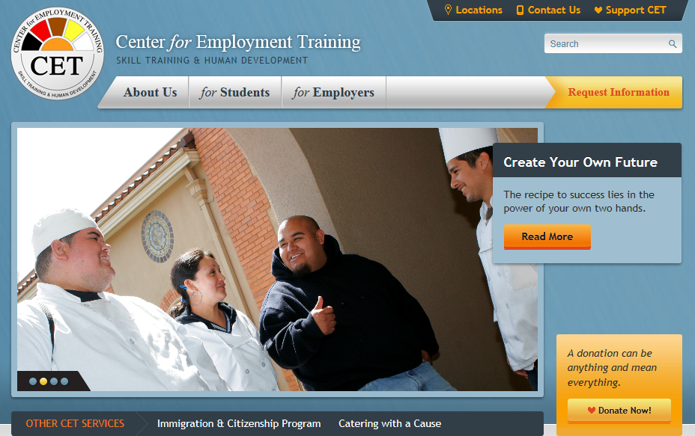
CET Case Study
Staffing
Bilingual Bicultural Financial Aid Counselor
Understand parent/student relationships
It is about jobs

Slide 28
Actions
Get in to the community
Establish mentoring opportunities
Provide information in English and Spanish
Involve students and parents
Address information gap in college pricing and affordability

Slide 29
THANK YOU!
Elsa Garcia de Leon, CET
ewellsgarcia@eei.edu
Jacquie Carroll, American Student Assistance
jcarroll@asa.org

